Slide 1
General SHAC Meeting
Wednesday, APRIL 10, 2024

Slide 2
Welcome & Mindful Moment
Allison Thummel
FBISD SHAC Chair

Slide 3
Physical Activity Promotion in Schools: Providing More Than Just Health Benefits
Fort Bend ISD SHAC Meeting, April 2024
Presented by: Derek Craig, PhD & Timothy Walker, PhD

Slide 4
Stand Up, Sit Down

Slide 5
Stand Up, Sit Down
Stand up if you are a member or a guest of the Fort Bend ISD SHAC

Slide 6
Stand Up, Sit Down
Stand up if you are from Texas

Slide 7
Stand Up, Sit Down
Stand up if you are a
community representative

Slide 8
Stand Up, Sit Down
Stand up if you are a
school/district representative

Slide 9
Stand Up, Sit Down
Stand up if you are a
student representative

Slide 10
Stand Up, Sit Down
Stand up if you are a
parent representative

Slide 11
Presentation Overview
Why promote physical activity in schools?
What can schools and districts do to promote activity?
What challenges exist?
How do we move this work forward?

Slide 12
Why promote physical activity in schools?
Gallery Walk

Slide 13
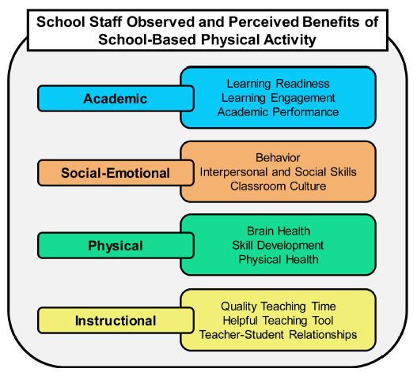
Walker, TJ, Craig, DW, Pfledderer, C., et al. (2023). Observed and perceived benefits of providing physical activity opportunities in elementary schools: a qualitative study. Frontiers in Sports and Active Living, 5, 1240382.

Slide 14
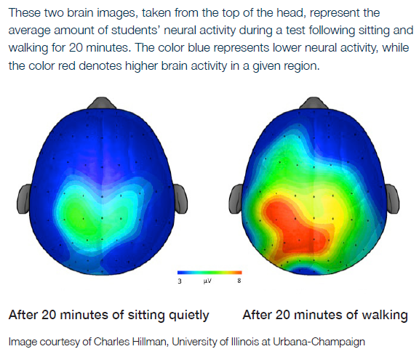
Hillman CH, Pontifex MB, Raine LB, Castelli DM, Hall EE, Kramer A. The effect of acute treadmill walking on cognitive control and academic achievement in preadolescent children. Neuroscience. 2009;159(3):1044-1054.

Slide 15
Schools Providing More Physical Activity Opportunities Had Higher Academic Ratings
Walker, TJ, Pfledderer, CD, Craig, DW, et al. (2023). Elementary school staff perspectives on the implementation of physical activity approaches in practice: an exploratory sequential mixed methods study. Frontiers in Public Health, 11, 1193442.

Slide 16
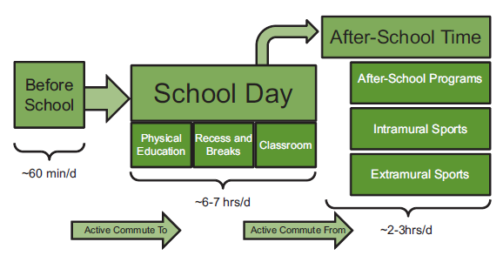
Whole-of-School Approach
Kohl III, H. W., & Cook, H. D. (Eds.). (2013). Educating the student body: Taking physical activity and physical education to school.

Slide 17
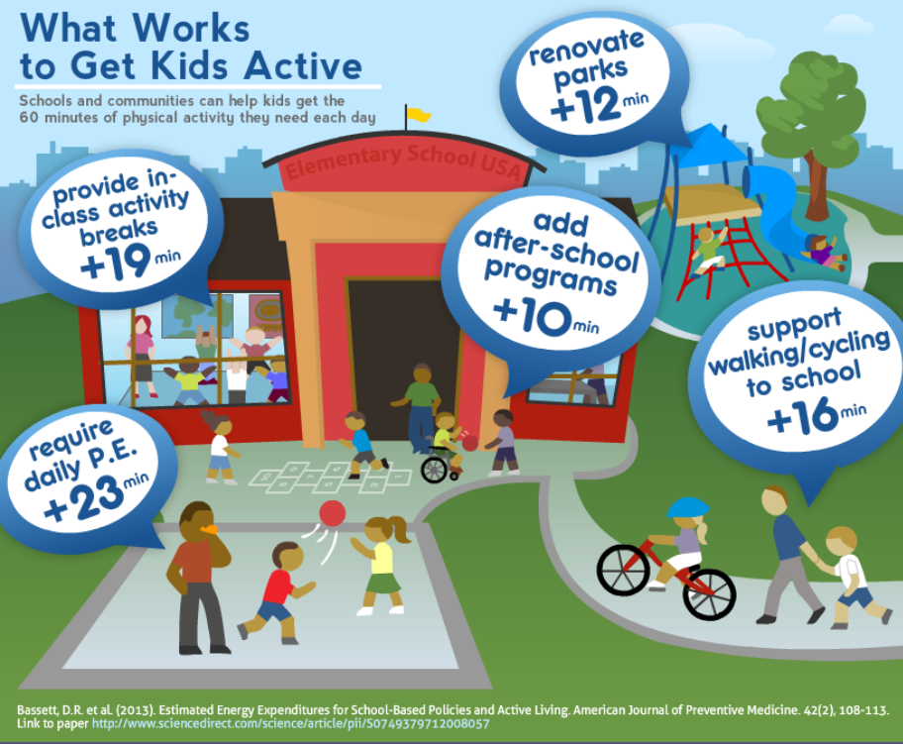

Slide 18
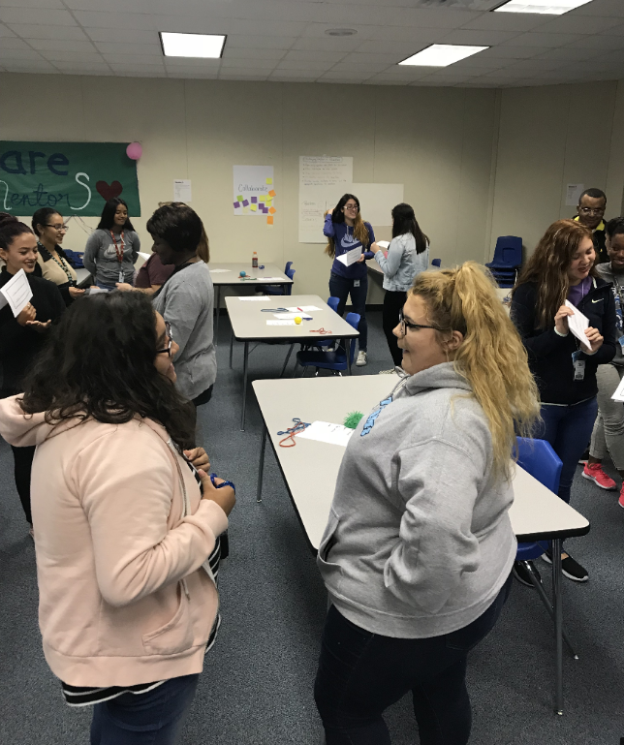
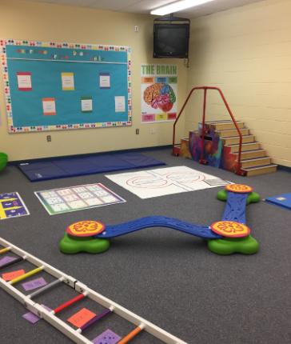
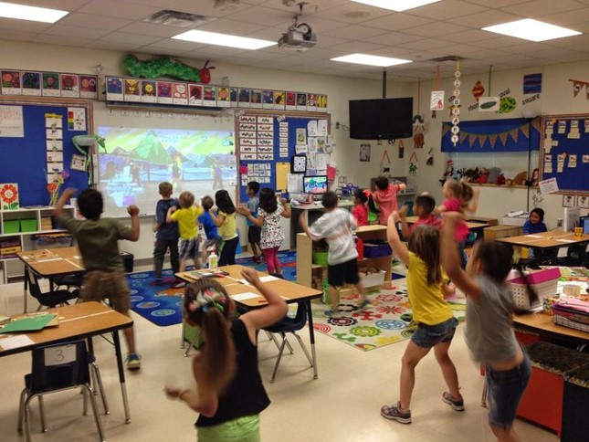
Classroom-based Physical Activity Approaches

Slide 19
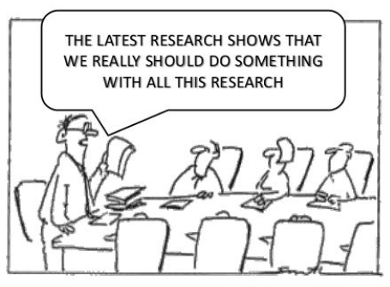
Current Challenges

Slide 20
The “Research to Practice Gap”
Translating research to practices takes approx. 17 years
Implementation will not happen on its own
Passive implementation approaches are mostly ineffective

Slide 21
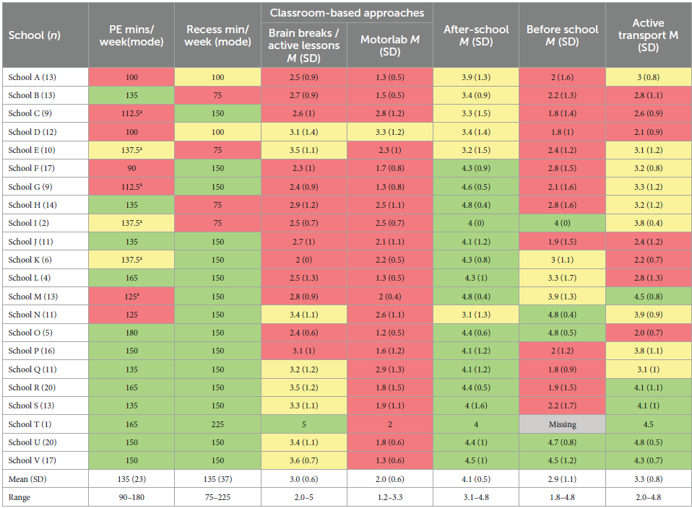
Walker, TJ, Pfledderer, CD, Craig, DW, et al. (2023). Elementary school staff perspectives on the implementation of physical activity approaches in practice: an exploratory sequential mixed methods study. Frontiers in Public Health, 11, 1193442.

Slide 22
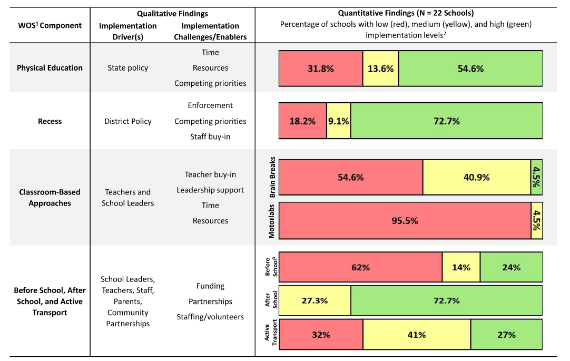
Walker, TJ, Pfledderer, CD, Craig, DW, et al. (2023). Elementary school staff perspectives on the implementation of physical activity approaches in practice: an exploratory sequential mixed methods study. Frontiers in Public Health, 11, 1193442.

Slide 23
Walker, TJ, Pfledderer, CD, Craig, DW, et al. (2023). Elementary school staff perspectives on the implementation of physical activity approaches in practice: an exploratory sequential mixed methods study. Frontiers in Public Health, 11, 1193442.

Slide 24
Walker, TJ, Pfledderer, CD, Craig, DW, et al. (2023). Elementary school staff perspectives on the implementation of physical activity approaches in practice: an exploratory sequential mixed methods study. Frontiers in Public Health, 11, 1193442.

Slide 25
Ways to Support Physical Activity
Monitor what schools are doing
Interviews, surveys, direct observations
Promote the benefits of physical activity
Academic, social-emotional, instructional, and physical
Build capacity within the district and schools
Educate
Motivate
Develop/enhance skills
Reduce barriers (e.g., lack of resources, competing priorities)

Slide 26
Questions?
Derek Craig, PhD
Postdoctoral Research Fellow
Derek.W.Craig@uth.tmc.edu
Timothy Walker, PhD
Assistant Professor
Timothy.J.Walker@uth.tmc.edu

Slide 27
Action-Based Learning in Fort Bend ISD FBISD ABL Teachers John Needem, Steven Buckley, Tracy Johnson, & Ashley East

Slide 28
What is ABL?
Action Based Learning™ is based on the brain research that strongly supports the link between movement and learning. We know that healthy, active students, make better learners! So how do we apply this to the classroom?
Action Based Learning! ABL provides students an advantage to learn. The focus is on creating an optimal learning environments for all students, through movement!
Action Based Learning stations in the classroom can be used to prepare the brain for learning, reinforce academic content, and strengthening the 12 foundations of Learning Readiness.
Notes:
Buckley

Slide 29
Why ABL?
It increases focus and attention. Grades Improve. Less office referrals. Decreases behavioral issues
Action Based Learning areas are a reprieve from the traditional sedentary learning environment.
It makes learning fun, students eager to come to class.
Research tells us we can use purposeful movement to fill in and strengthen developmental gaps. We are providing students an advantage to learning.
We are impacting the lives of children!
Notes:
Buckley

Slide 30
Where is the most restrictive environment for learning at school?
Notes:
Ashley

Slide 31
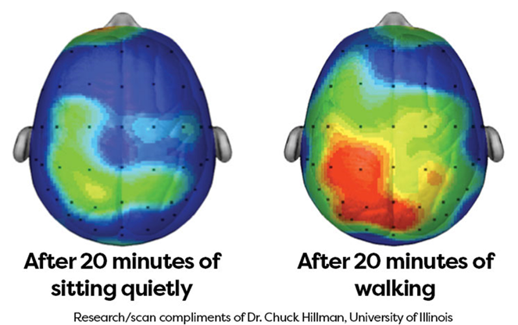
Effects of Exercise on the Brain
Notes:
Ashley-When you exercise, your body releases chemicals such as dopamine and endorphins in your brain that make you feel happy. Not only is your brain dumping out feel-good chemicals, but exercise also helps your brain get rid of chemicals that make you feel stressed and anxious.

Slide 32
Notes:
Ashley

Slide 33
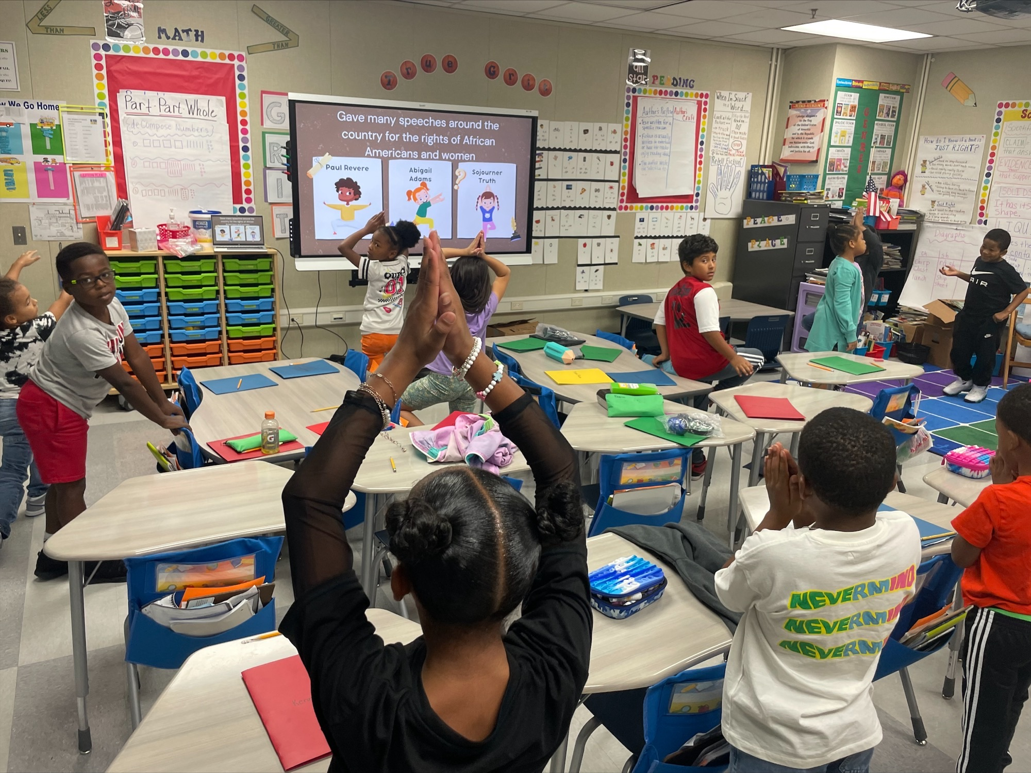
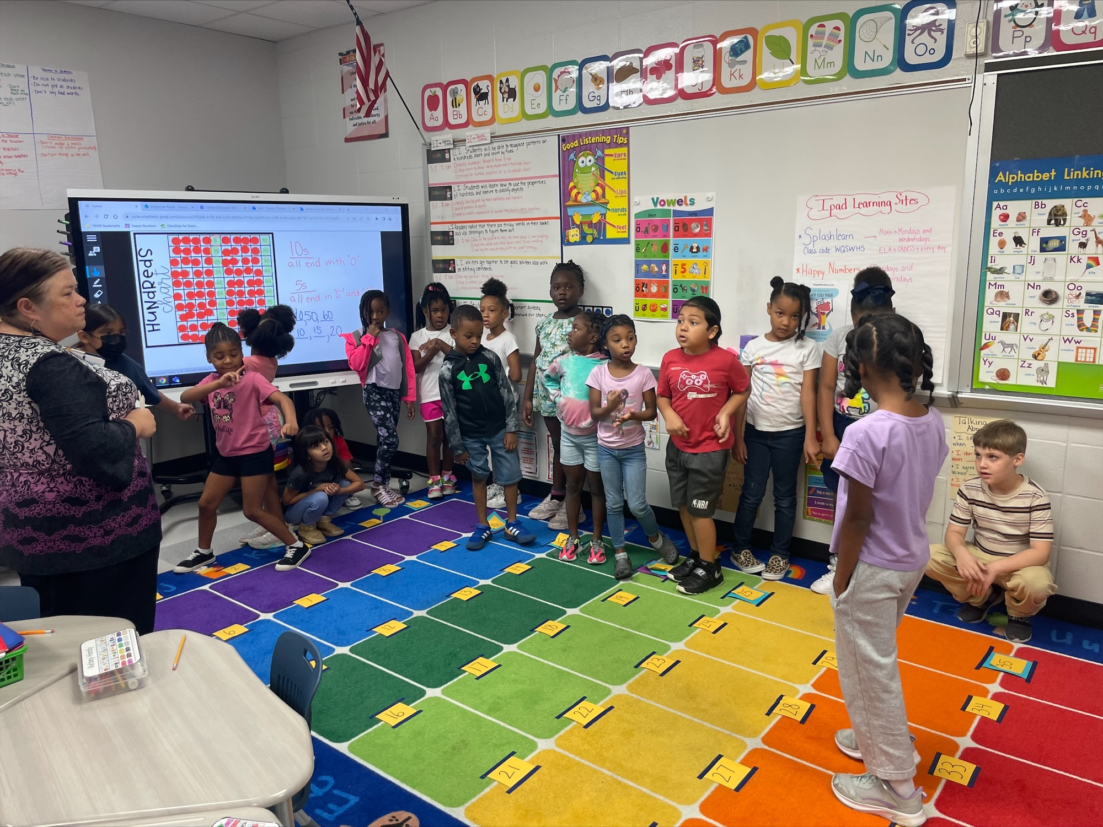
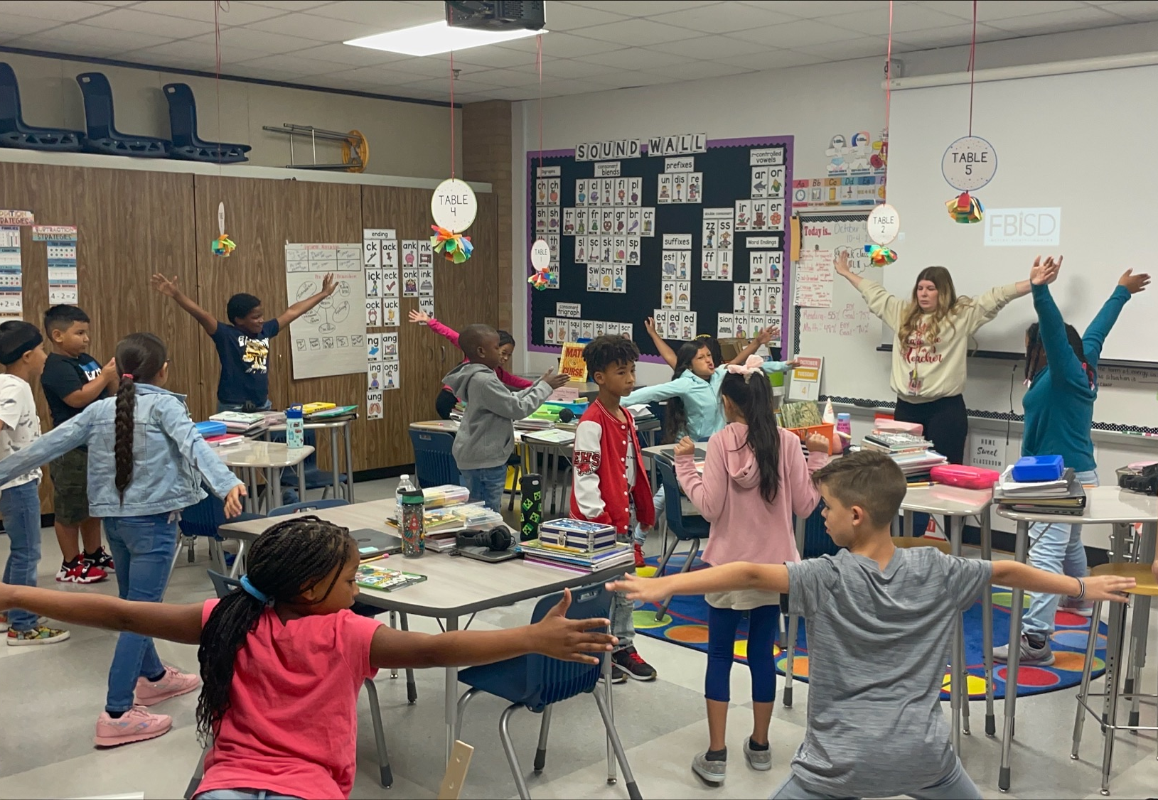
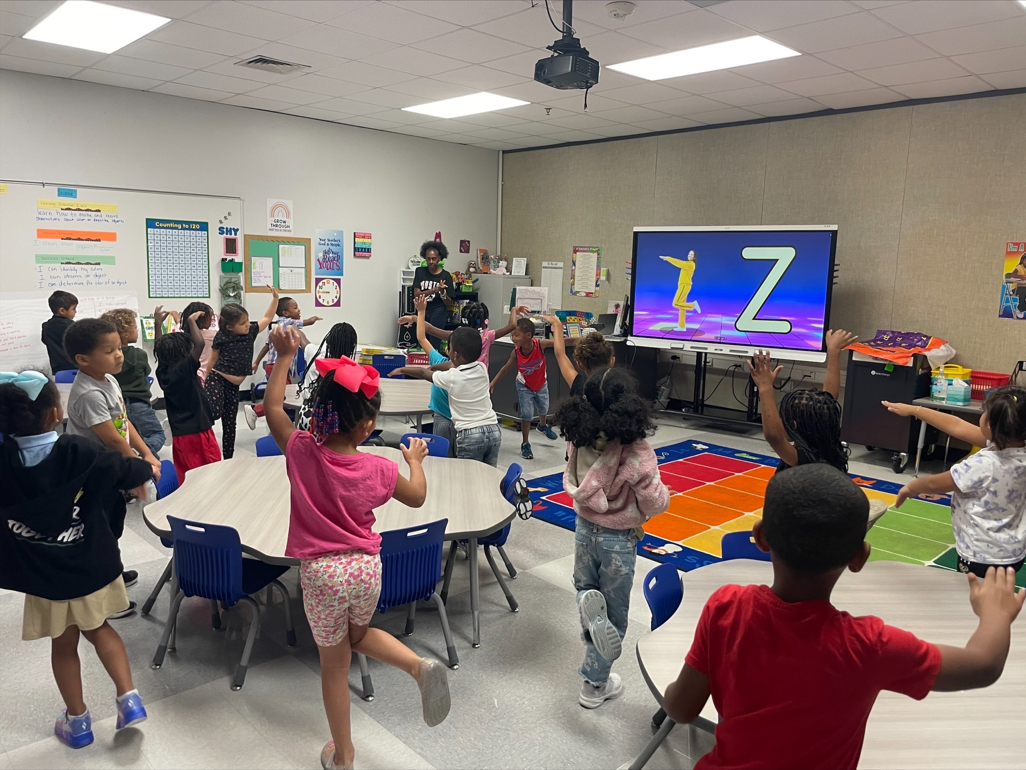
What does more movement in the classroom mean for our students?
Grows brain cells
Prepares the brain for learning
Strengthens memory
Regulates behavior
More focused
Increases Student Ownership of Learning
Promotes cooperation & communication skills
Blue Ridge/Briargate ES​
Notes:
Ashley –We collaborate with our teachers to imbed meaningful moving within their lessons. This helps to keep students engaged and maximize their learning.

Slide 34
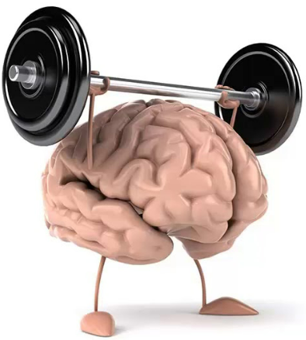
Let’s try it!
Notes:
John-Gallery Walk-Movement in the classroom.

Slide 35
ABL 12 Foundations Of Learning
Crossing the Midline
Body in Space
Balance
Visual Development
Rhythm
Tactile Learning
Motor Skills
Hand/Eye/Foot Coordination
Physical Fitness
Cardiovascular Health
Problem Solving
Self Management
Notes:
Tracy -Discuss examples of foundations and their specific positive outcomes. A few example slides follow.

Slide 36
A little more Science..
Brain Link:
Crossing the midline powers up neurons!
Crossing the midline connect the brain hemispheres and help to organize the brain.
Classroom Relevancy:
Aide the brain in placing words on a page, reading words from left to right, writing patterns in a sequence
Decode information coming in, get information from the brain to the paper, and move from lower to higher level thinking
Notes:
Tracy

Slide 37
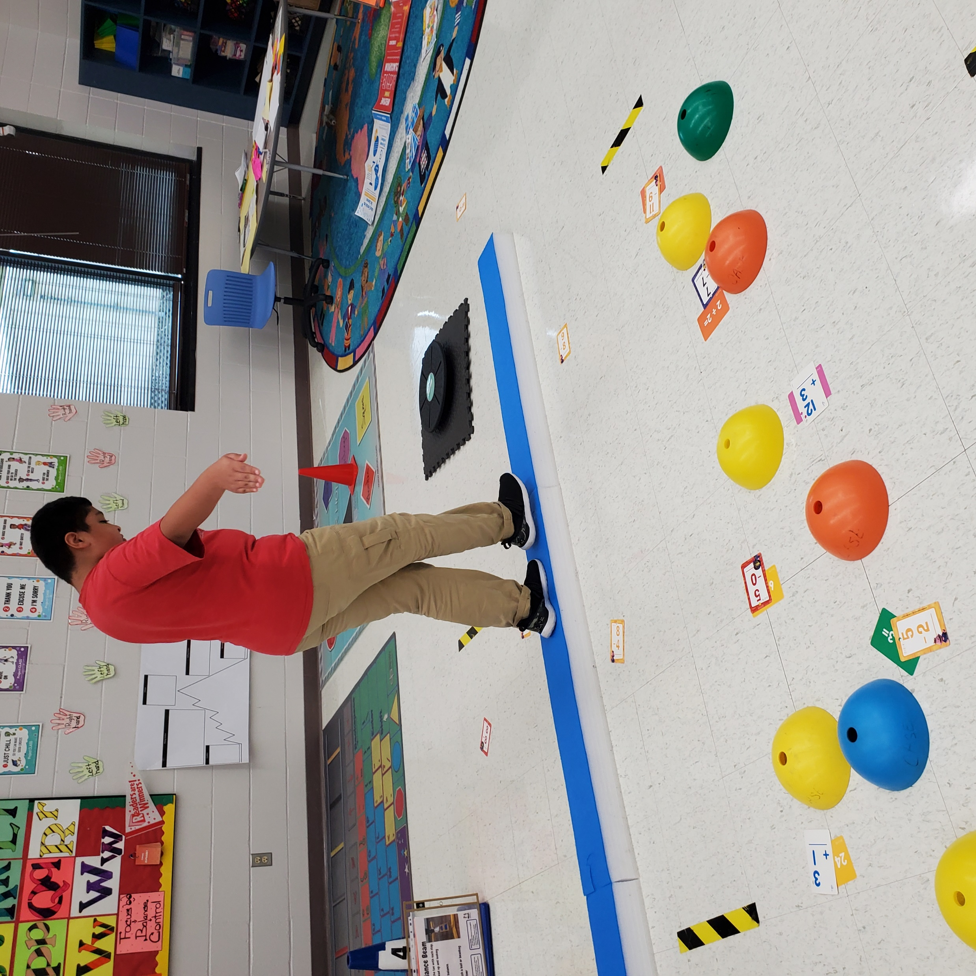
ABL LAB
12 Foundations Of Learning
Action Based Learning
Ridgegate Elementary
Balance
Spatial Awareness
Notes:
Tracy

Slide 38
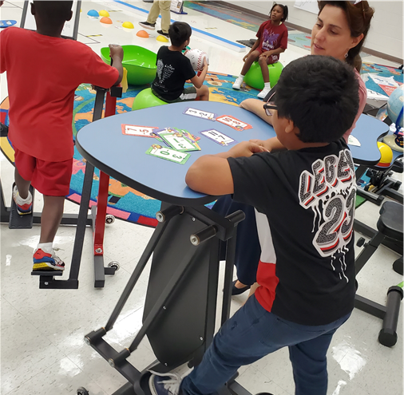
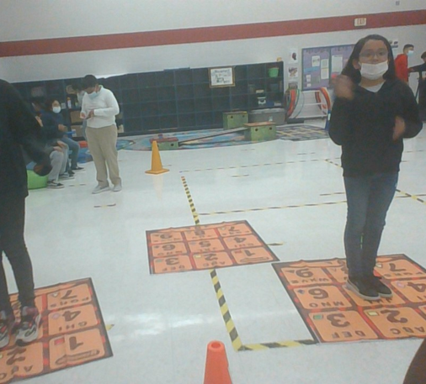
Action Based Learning
Ridgegate Elementary
Crossing the midline
Cardiovascular
Notes:
Tracy

Slide 39
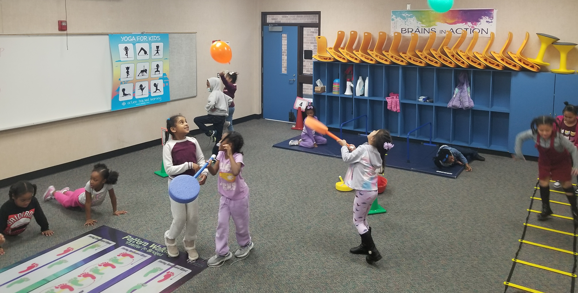
Action Based Learning Lab​
Lantern Lane Elementary​ 1st Grade
Hand/Eye Coordination
Cross The Midline
Balance
Physical Fitness
Notes:
Buckley

Slide 40
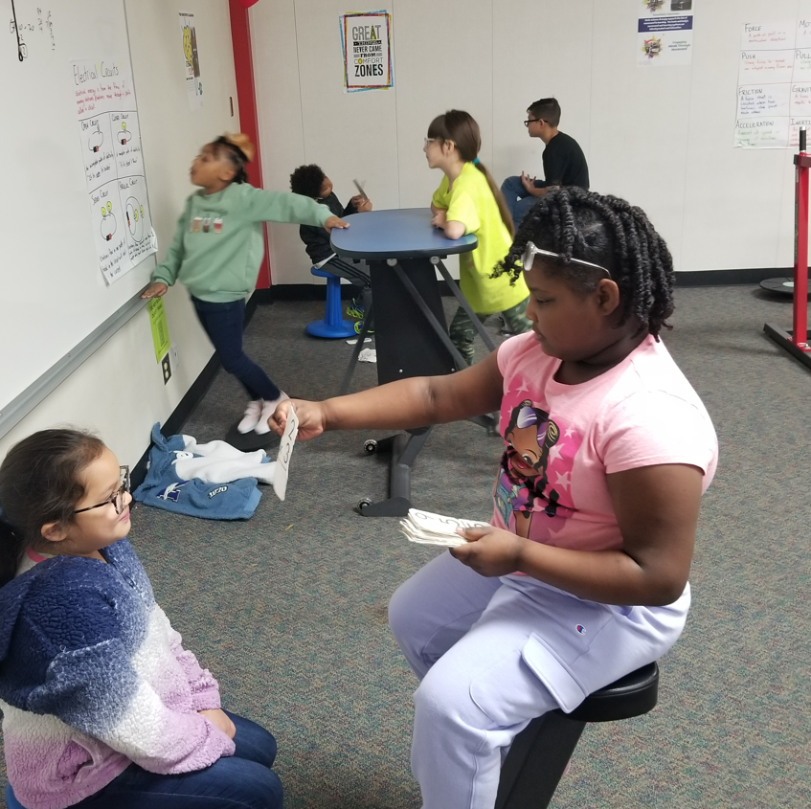
Action Based Learning Lab
Lantern Lane Elementary 3rd Grade
Multiplication Flash Cards
Electrical Circuits Anchor Chart
Notes:
Buckley

Slide 41
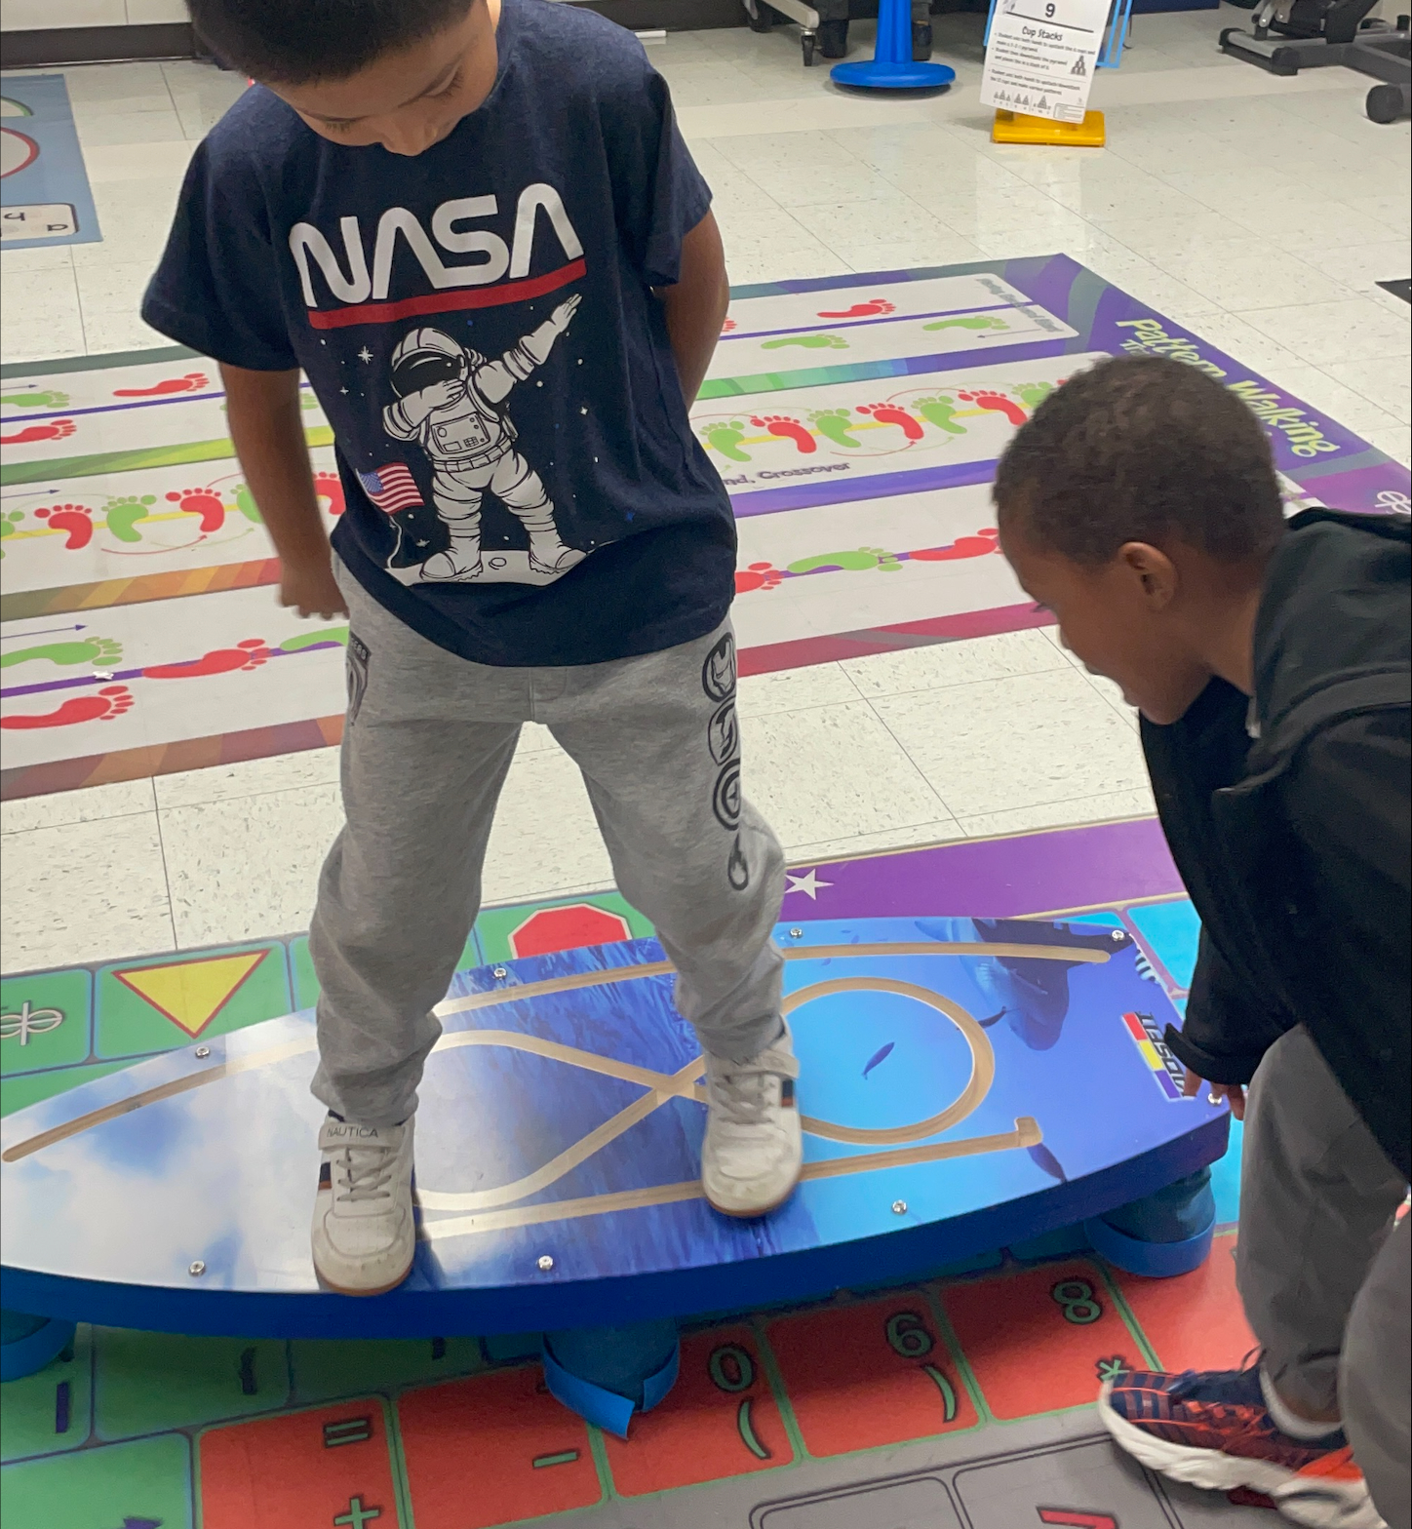
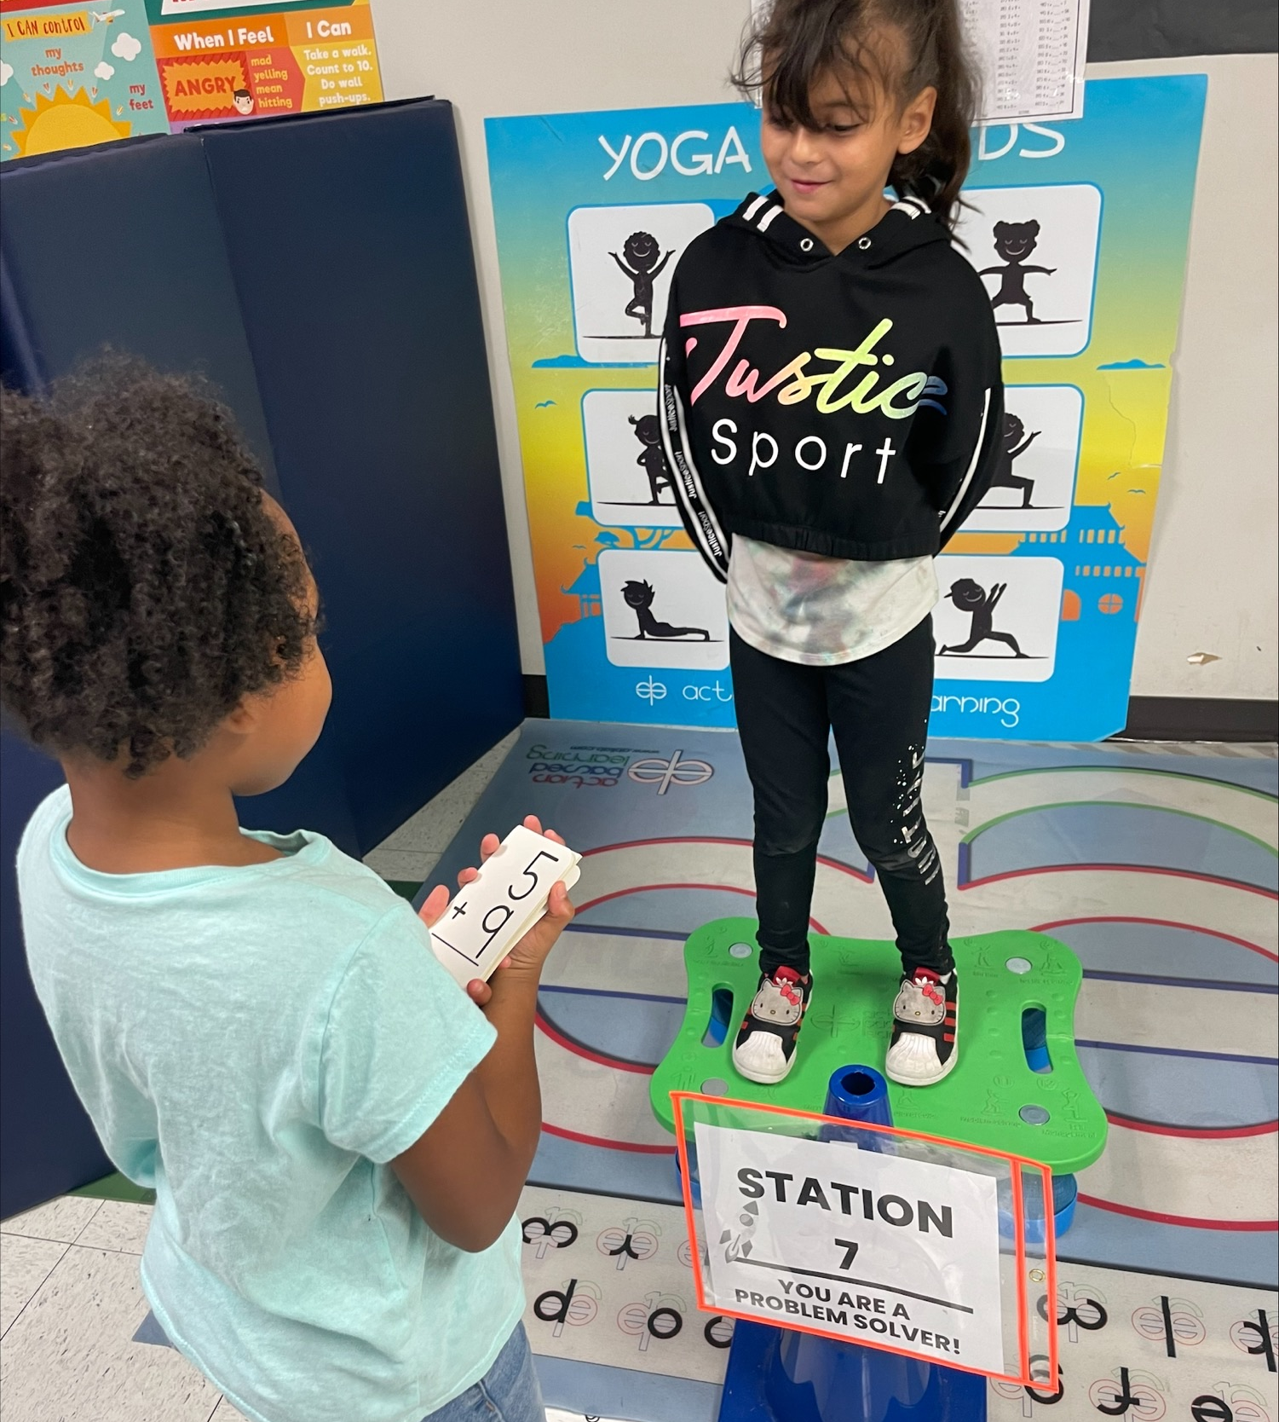
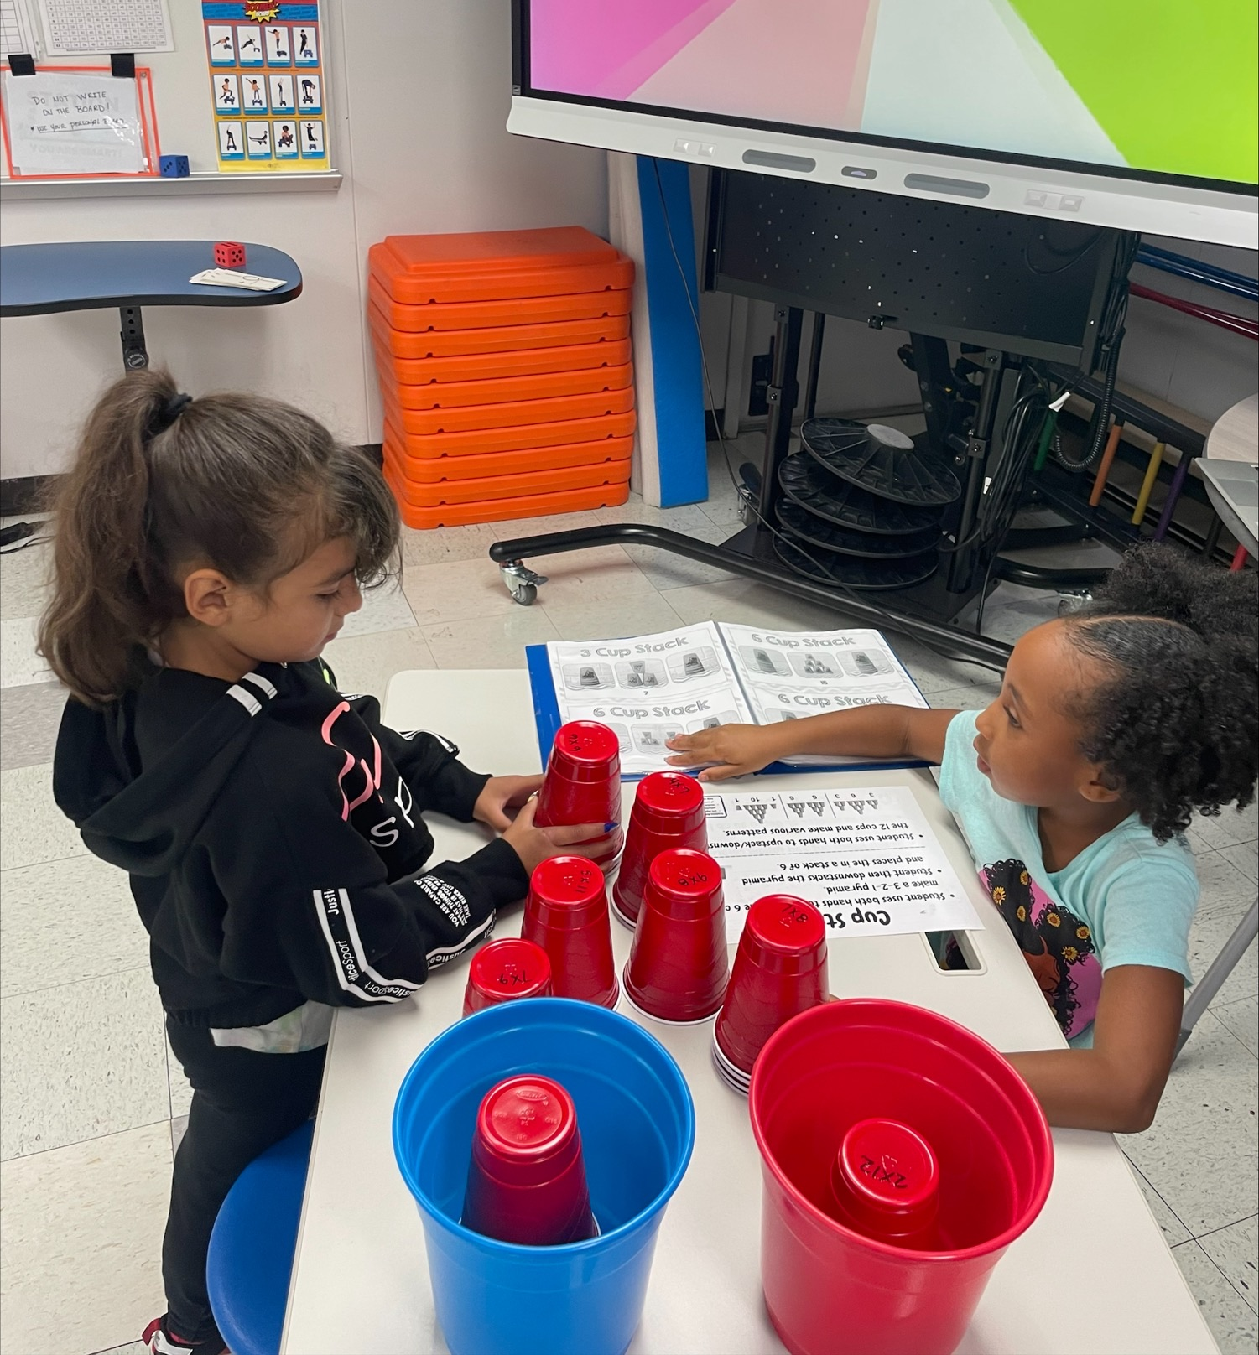
Blue Ridge/Briargate ES Action Based Learning Lab
Visual Development
Balance
Body In Space
Motor Skills
Notes:
Ashley

Slide 42
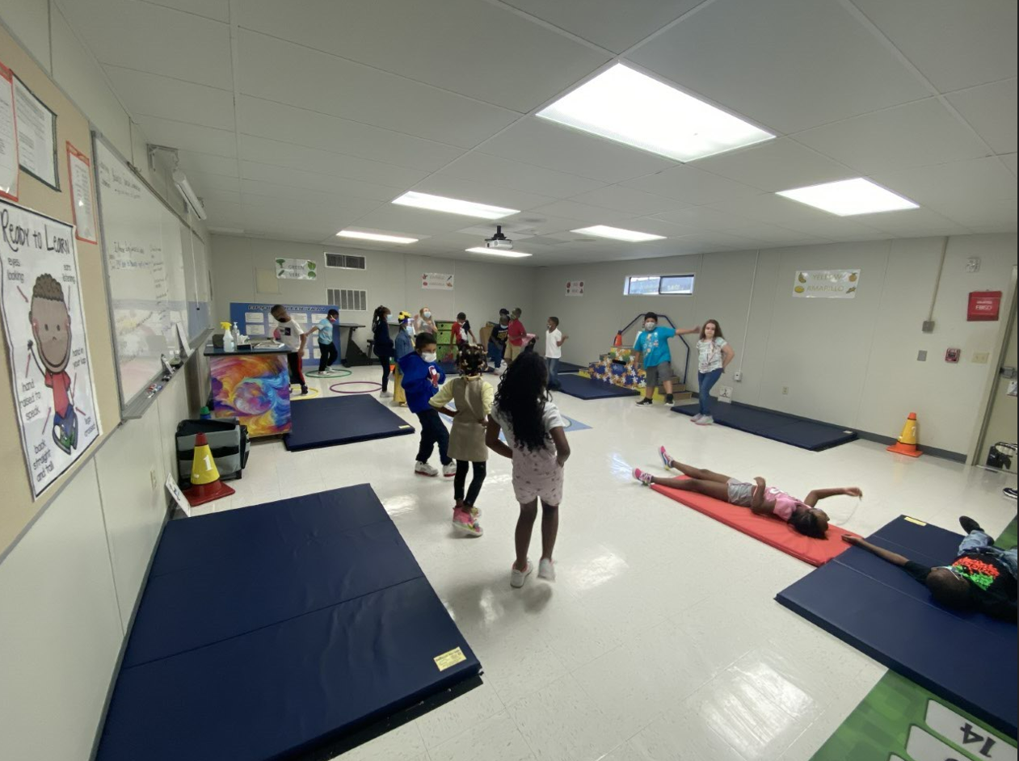
Action Based Learning Lab
Hunters Glen Elementary
Notes:
John

Slide 43
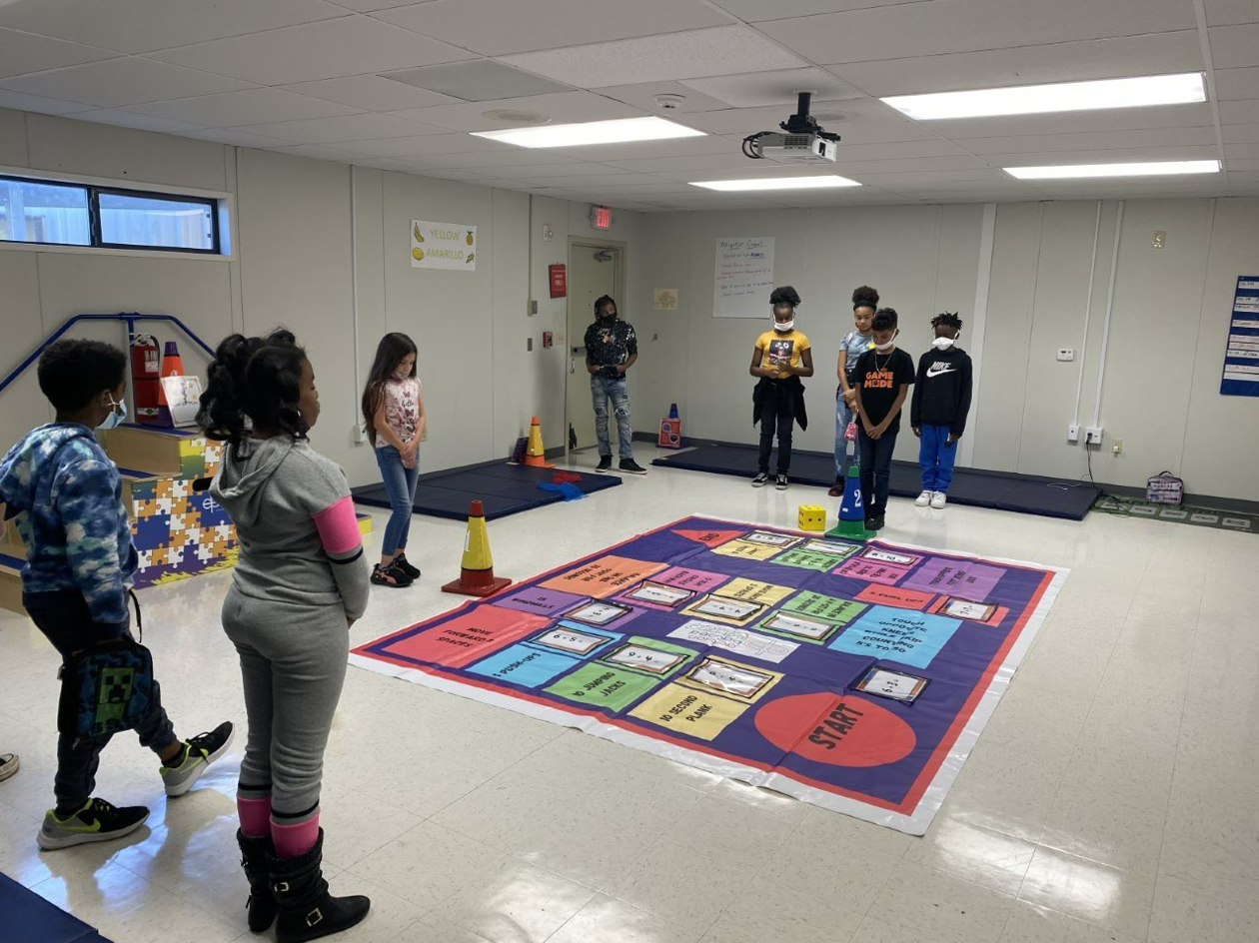
Action Based Learning Lab
Hunters Glen Elementary
Notes:
John

Slide 44
Current Trends
2019 –20 (1st year of ABL on campus)
Total Skyward Referrals: 374
Most Common Referral: Safety Rule Violation & Mutual Combat
Most Common Action: ISS/School Based Strategies
2020-2021
COVID School Year
Total Skyward Referrals
2021-22
Total Skyward Referrals: 52
Most Common Referral: Disruptive Behavior
Most Common Action: Restorative Conference/Parent Conference
As of 2/01/22
2022-2023
Total Skyward Referrals:26
Most Common Referral:
Inappropriate Physical Contact
Most Common Action: Contact with parent
Notes:
John

Slide 45
December Math DCA – 2nd grade​
Blue Class – teacher uses ABL as part of the daily routine including regular lab attendance.​
Red Class – minimal ABL is used within the daily routine & no regular lab attendance.​
Notes:
John

Slide 46
Sight Words
Class with ABL​
Class without ABL​
(# of students who knew the words)
Notes:
John

Slide 47
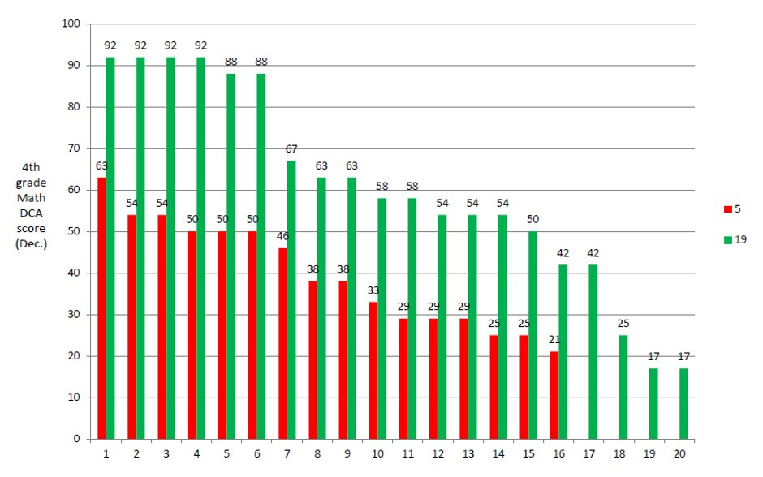

Slide 48
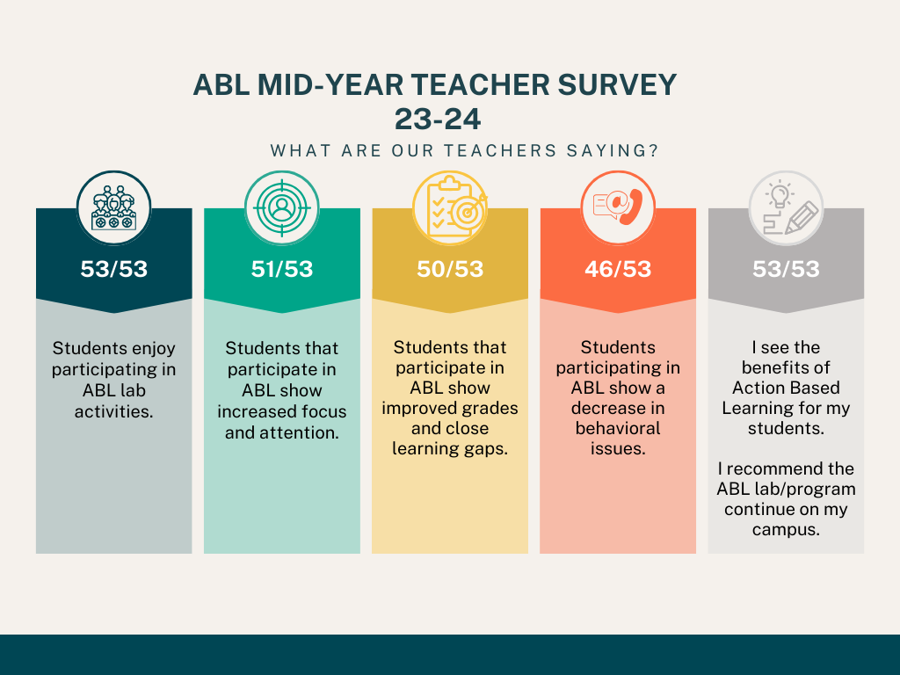
Notes:
Ashley

Slide 49
EXERCISE GROWS BRAIN CELLS!

Slide 50
Brain Break District Student Wellness Coalition Members Paresh Cl & Naomi K

Slide 51
2024-2025 SHAC Updates Allison Thummel FBISD SHAC Chair

Slide 52
2024-2025 SHAC Updates
SHAC Presenting to BOT May 13
Legislative Priorities
SHAC Executive Team (Vote, if quorum)
Membership (Vote, if quorum)

Slide 53
2024-2025 SHAC Legislative Priorities (approved)
The FBISD SHAC Supports:
The Texas’ Whole School, Whole Community, Whole Child (WSCC) Model for coordinated school health and supports measures that strengthen Local Education Agencies’ (LEA) implementation of policies and practices consistent with this approach.
Measures that enhance local communities’ ability to inform local decision-making of LEAs through the formation or support of formal advisory groups such as SHACs.
Measures encouraging physical fitness and Action Based Learning, including effective use of fitness assessments.
Funding for a multi-tiered system of mental and behavioral health support that fosters safe and healthy school environments for students, educators and staff.
Measures to ensure that all children receive access to healthy school meals, including breakfast and lunch to reduce food insecurity and hunger.
Improved, continual, reliable funding for access to evidence-based mental health services.

Slide 54
SHAC Legislative Priorities (proposed)
The FBISD SHAC Supports:
Measures encouraging physical fitness and Action Based Learning, including effective use of fitness assessments.
Funding for a multi-tiered system of mental and behavioral health support that fosters safe and healthy school environments for students, educators and staff.
Measures to ensure that all children receive access to healthy school meals, including breakfast and lunch to reduce food insecurity and hunger.
Notes:
Presenter: Allison
Time: 3 minute
Say: Our first goal during this school year was designing 6 Legislative Priorities, and SHAC has narrowed it down to these three. We hope that the BOT will take note of these LPs and possibly incorporate one or parts of these, into their BOT LP. These are the measures that we the SHAC support, and encourage individuals to advocate for. Reaching out to our representatives was encouraged to all the SHAC members and guests. Being involved in the legislative process is important.

Slide 55
SHAC Nominations & Vote Jenna Ross FBISD SHAC Secretary

Slide 56
SHAC Executive Team Nominations
Chair: Catalina Flores-Rau
Vice Chair: Nicole Juracek
Secretary: Derek Craig

Slide 57
SHAC Nominations: Chair- Catalina Flores-Rau
Background:
Degree in Chemical Engineering from Iowa State
Former employee of Dow Chemical (Plastics & Supply Chain)
Non-profit roles: PTO, Surfer Swim Team, L.I.F.E Houston
Students in District
8th grader @ First Colony MS & 10th grader @ Clements HS
Why SHAC?
I believe the SHAC is a place for us to really unify our campuses and understand the issues we have related to fitness, mental health, and safety. By working as a team, we can serve our community and help our students and staff excel.

Slide 58
SHAC Nominations: Vice Chair- Nicole Juracek
Background:
Degree in Economics from UC Santa Barbara
Works in corporate retirement & acquisitions
Enjoys growing veggies & creating butterfly gardens
Garden Coordinator for Neill for 3 yrs
Students in District
4th grader @ Neill ES& 6th grader @ Bowie MS (2024-25)
Why SHAC?
I am interested in SHAC because of the healthy choices that schools can make together. I have enjoyed helping the Harvest of the Month program grow, and I hope to be able to get more gardens on school grounds and help the garden coordinators work together to ensure these gardens thrive and grow!

Slide 59
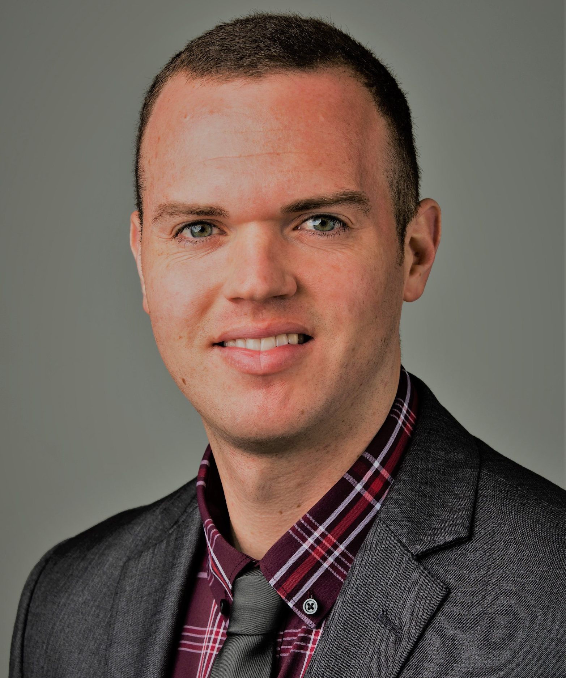
SHAC Nominations: Secretary-Derek Craig
Background:
PhD, Health Promotion and Behavioral Sciences (UTH-SPH)
MPH, Community Health Practices (DePaul Univ.)
Students in District
Kindergartner in Fall 2025 @ Blue Ridge ES
Why SHAC?
Being able to give back in my own community to positively impact school health and student’s development and
Collaborating with district staff and community members to provide students with evidenced-based school health programs that ensure making a healthy choice is an easy choice

Slide 60
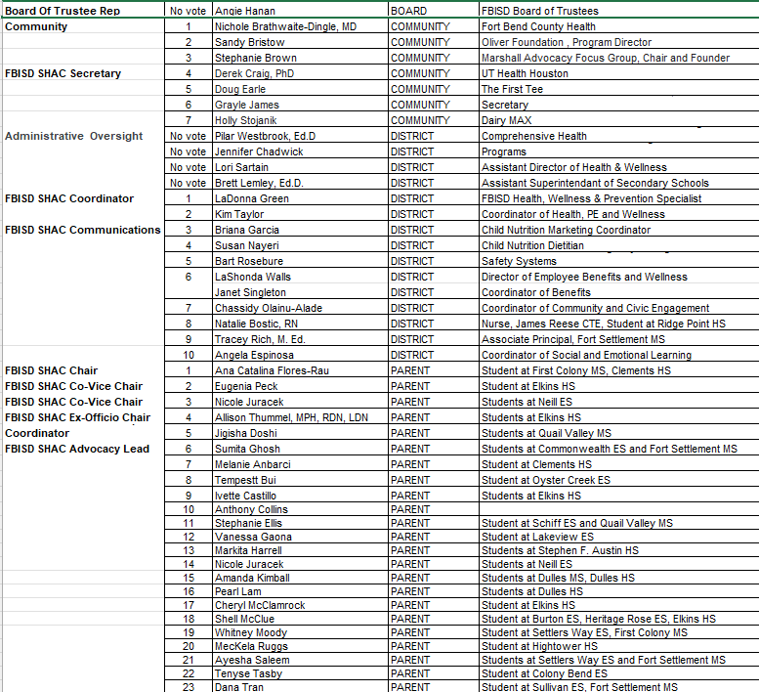
Members:2024-25

Slide 61
Vote
SHAC Meeting Minutes
February 28, 2024
Jenna Ross
FBISD SHAC Secretary

Slide 62
Civic Engagement Announcements Chassidy Olainu-Alade FBISD Coordinator of Community and Civic Engagements- Communications

Slide 63
Election Season
“Dos and Don’ts”
FBISD Legal Services & Communications Department

Slide 64
What is School Electioneering?
School Elec­tion­eer­ing
Texas school officials and employees should be aware of the following:
According to Section 255.003(a) of the Texas Election Code, an officer or employee of a political subdivision may not knowingly spend or authorize the spending of public funds for political advertising.
In addition, school district officials may not use public resources to advocate for or against particular political candidates and/or groups of political candidates.
Furthermore, the Texas Election Code prohibits the board of trust of a school district from using state or local funds “to electioneer for or against any candidate, measure, or political party.
Tex. Educ. Code Sec. 11.169.

Slide 65
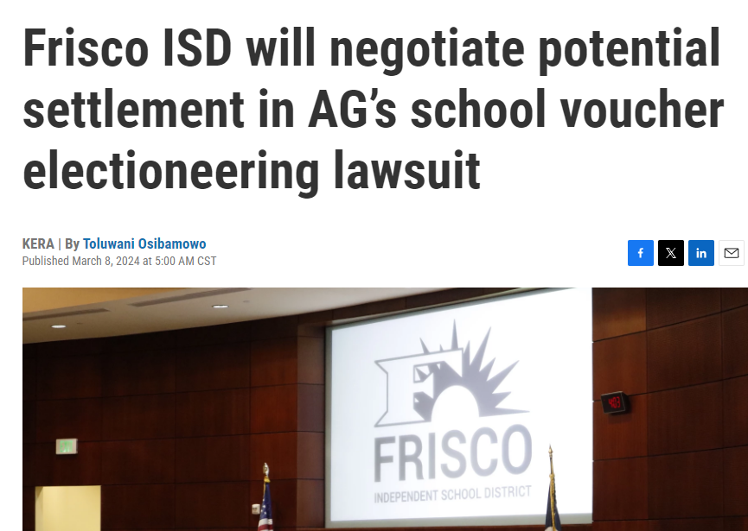
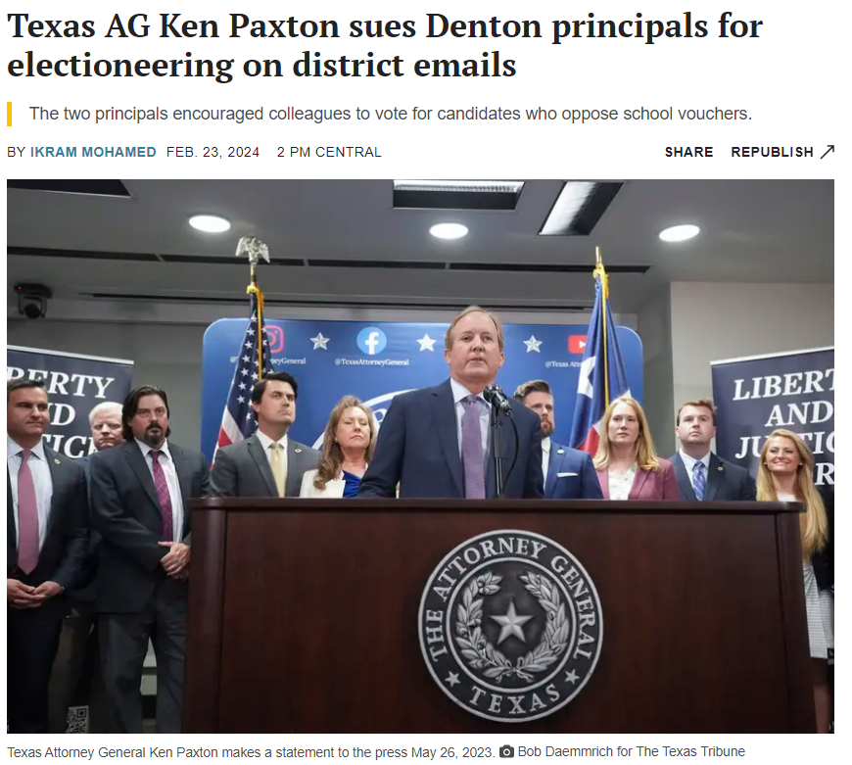
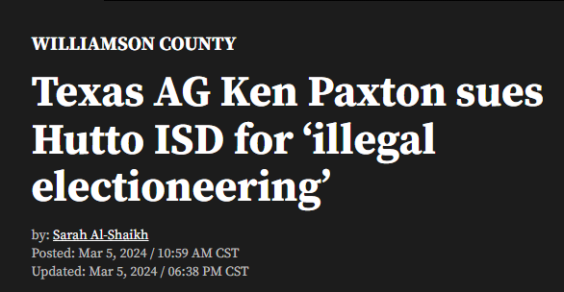
Why does this matter?
Notes:
Currently there are active lawsuits against the following districts:
Denton
Frisco
Dennison
Huffman
Hutto
Aledo
Castleberry

Slide 66
Profile of a Graduate – Voting
Fort Bend ISD encourages its employees to be engaged citizens by voting and participating in the political process.
By exercising our right to vote we model the attribute of Compassionate Citizenship, included in the District’s Profile of a Graduate.
In addition to voting, as private citizens, employees may engage in political activities so long as they:
1. Occur off school district property 2. After work hours, and 3. Do not involve the use of any district resources, including district email and mailboxes

Slide 67
Allowed Activities
FBISD employees MAY:
Encourage others to vote and participate in the political process
Contribute funds to, or raise funds for, a political action committee or candidate
State opinions about a candidate or measure through an individual’s personal email, social media page or website
Organize, sponsor, and attend campaign-related events and participate in campaign volunteer activities (phone banks, etc.)
Display campaign materials (buttons, signs, posters, etc.) anywhere off school property; bumper stickers on cars parked in school parking lots are permissible

Slide 68
Prohibited Activities
FBISD employees MAY NOT:
Advocate in support for or against a candidate or ballot initiative during work hours
Use a district email address to send or receive messages containing political advocacy
Utilize district resources for anything that could be considered to be political advertising, including teacher or campus websites, social media pages, or newsletters
Make copies at school or use district postage to mail flyers or advertising
Display or distribute campaign materials (buttons, posters, etc.) on district property
Participate in campaign fundraising or campaign-related volunteer activities during work hours or while on district property
Transport students and/or employees to polling places during work hours

Slide 69
Voter Registration
Texas law requires eligible voters to register by the 30th day before Election Day.
The voter registration deadline for the May 4, 2024, Election is
Thursday, April 4, 2024.
For more information on voter registration visit: www.votetexas.gov

Slide 70
Voter Registration – High School Only
Texas Election Code 13.046 – High School Student Voter Registration
At least twice each school year, a high school deputy registrar (principal or designee) shall distribute an officially prescribed registration application form to each student who is or will be 18 years of age or older during that year, subject to rules prescribed by the secretary of state.
High School Voter Registration Compliance Notices
Voter Registration Applications for Students – Campuses should only be distributing voter registration applications coded for school use. These are to be obtained directly from the Texas Secretary of State Office by submitting the appropriate order form.
Voter Registration Collection and Submission – Voter registration applications must be reviewed for completion and accuracy before submission. Cards must be submitted within 5 days of collection. It is strongly advised that these be collected and submitted weekly. The cards can be mailed or dropped off at the Fort Bend County Voter Registrar’s Office.
Voter Registration Volunteers – Although appreciated, FBISD does not allow outside organizations or volunteers to facilitate voter registration on campus. Any voter registration activities that occur off campus or outside the building, must be conducted by certified Volunteer Deputy Registrars in Fort Bend County.
Please email Chassidy.Olainualade@fortbendisd.com for more information about High School Voter Registration.

Slide 71
Election Season is Here!
Early voting beings in April for the May election.
Several district facilities are in use as polling places for early voting, and many more will be polling locations for the general election day.
More details on voting schedules, polling locations, and election information can be found at fortbendvotes.org.

Slide 72
May 2024 FBISD Trustee Election
On May 4, 2024, Fort Bend ISD will conduct an election for Trustee positions 2 and 6.
All election rules and requirements apply to FBISD Trustee Elections.
More information regarding the Trustee election, including a list of candidates, is available at www.fortbendisd.com/boardelections.
Staff information and resources can be accessed at:
https://fortbend.sharepoint.com/teams/LegalServices
Notes:
https://fortbend.sharepoint.com/teams/LegalServices.

Slide 73
Subhead
https://fortbend.sharepoint.com/teams/LegalServices
fortbendisd.com/boardelections
fortbendvotes.org
www.fortbendisd.com/vote
www.votetexas.gov
https://www.texasattorneygeneral.gov/school-electioneering
Important Websites

Slide 74
Upcoming Events

Slide 75
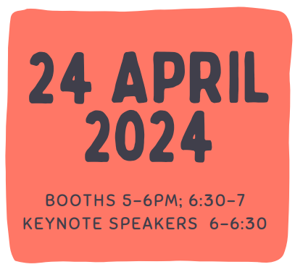
Subhead
Text

Slide 76
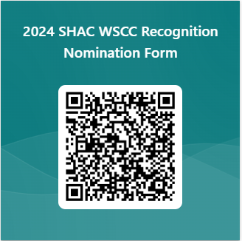
District Wellness Heroes
The SHAC WSCC Recognition Award was created to recognize campus groups, individual wellness champions and community partners who apply resources and knowledge to grow wellness on their campus, in the district, and in the community while further fostering the development of students to exemplify FBISD's Profile of a Graduate.
To nominate someone to be a Wellness Hero, scan the QR code and complete Google Form. Your favorite wellness champion could be one of FBISD’s Wellness Heroes.
Submit nominations to LaDonna Green (LaDonna.Green@fortbendisd.org)
by April 17 for students and May 1 for non-students

Slide 77
Whole Child Health Upcoming Events & Initiatives

Slide 78
May is Mental Health Awareness Month
Mental Health Counselor Day
May 5, 2024
Whether or not someone personally suffers with a mental health issue, Mental Health Awareness Month helps people recognize the ways mental illness impacts their lives, educates people about available services, and highlights ways to advocate

Slide 79
Nurse Appreciation Week
Fort Bend ISD Celebrates!
Nurse Appreciation Week
May 6-10, 2024
Nurse Appreciation Day
May 8, 2024
The American Nurses Association is celebrating National Nurses Week 2024 May 6 - May 12, and throughout May. This year's theme, "Nurses Make the Difference," honors the incredible nurses who embody the spirit of compassion and care in every health care setting

Slide 80
DEA Drug Take Back
Fort Bend will participate in DEA’s National Drug Take Back
At
Fort Bend ISD Administration Building
Parking Lot
16431 Lexington Blvd
Sugar Land, TX 77479
April 27, 2024
10 AM – 2 PM

Slide 81
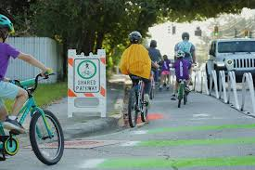
National Bike to School Day
National Bike to School Day
May 16, 2024
Bike & Roll to School Day invites participants to celebrate the joy of active commuting while building a sense of community and school spirit. Whether addressing the need to make routes to school safer for active trips or encouraging children and teens to be more active, these events can be powerful tools to inspire lasting change. Of course, they are also fun!

Slide 82
Million Mile Month
To register to participate in the Million Mile Month, please visit the website linked below:
https://app.healthcode.org/dashboard/mmmapril2024

Slide 83
Brighter Bites Volunteers
Brighter Bites creates healthy behavior change by providing kids & families access to fresh produce & #nutritioneducation. Interested in packing fresh produce? Join us for a Produce Packing!
All volunteers must have completed the FBISD background check.
Tuesdays, 9:30-11:30
https://www.signupgenius.com/go/5080C4BA4AE2FA20-48255547-brighter#/

Slide 84
SHAC Liaison & DSWC Action Items
Judge Nutrition Contest-April 12 @ Harvest Green. Susan Nayeri for info.
Join FBISD in Million Mile Month
Drop old drugs off at Drug Take Back Event, April 27, 11am-1pm @ FBISD Admin
Attend Whole Child Health Wellness Fair April 24th at Wheeler Stadium, 5-7pm
Liaisons only: Volunteer at Brighter Bites

Slide 85
Meeting In Closed Session Breakout Session-SHAC Goals

Slide 86
Meeting Closure
Next Fort Bend ISD General SHAC Meeting
Fort Bend ISD Administration Building
15431 Lexington Blvd
Sugar Land, TX 77479
May 10, 2024
12:00 PM - 2:00 PM

Slide 87
FORT BEND ISD
16431 Lexington Blvd.
Sugar Land, TX 77479
281-634-1000
www.fortbendisd.com

